Slide 1
The workflow and preparation for conference, seminar and symposium
101102503曾郁茹
101102016陳奕臻
100102034唐嘉伶
101102026余姿瑩
101102505蘇俞臻

Slide 2
Features
conference
seminar
symposium
share opinions
more lectures on
a single topic
educational connotation
showcase new theories,
methods and techniques
discuss the common question and conclude it with recommendation
lecture

Slide 3
The trend:
audio visual aids

Slide 4
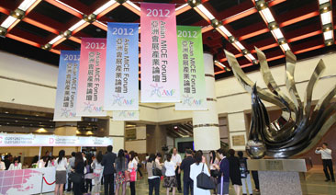
Asian MICE Conference
October 10th, 2014

Slide 5
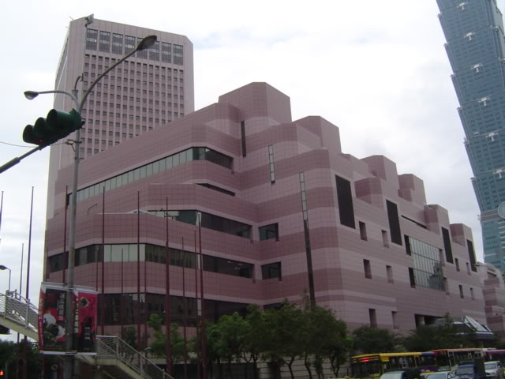
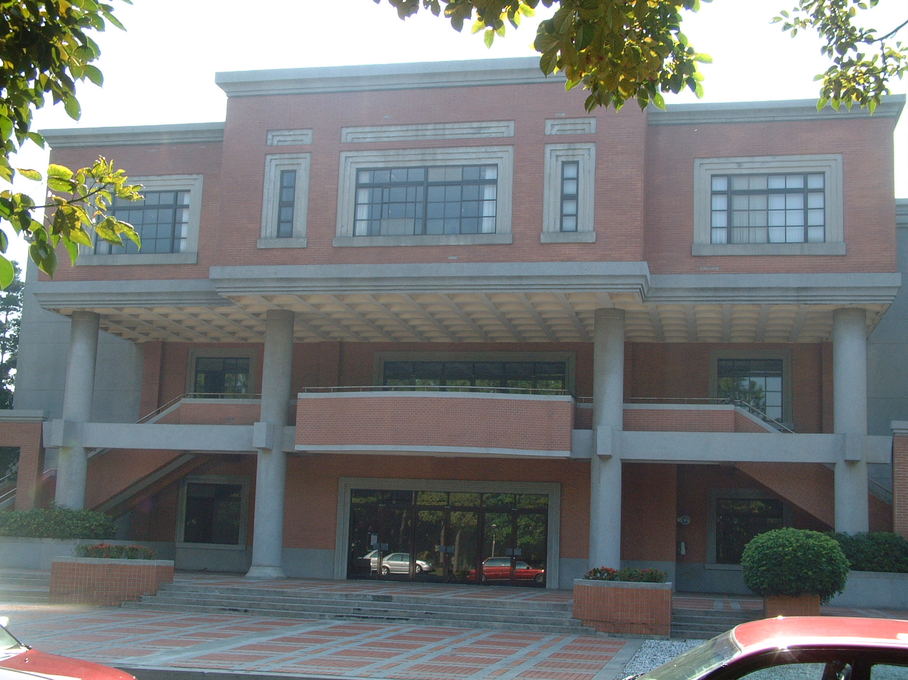
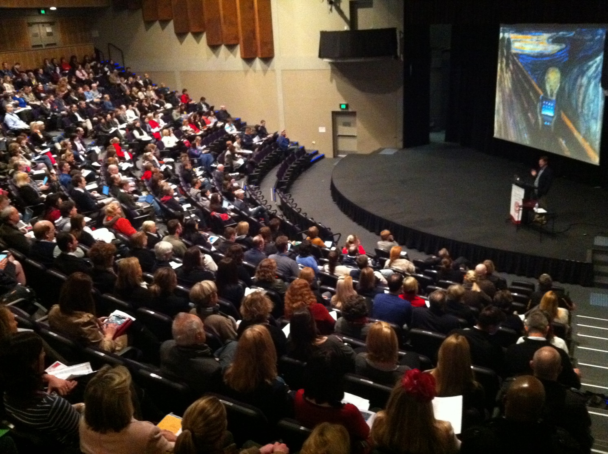
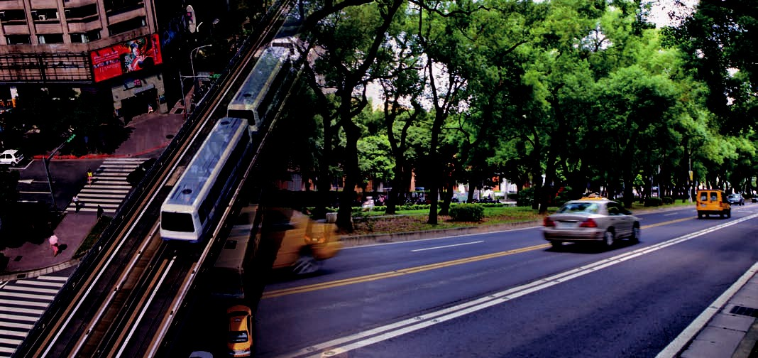
Venue Reservation

Slide 6
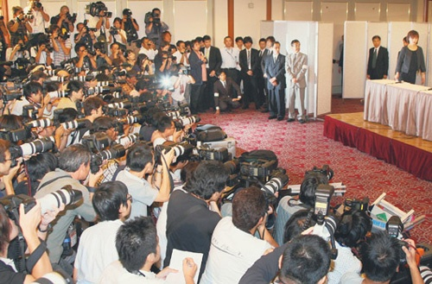
Publicity

Slide 7
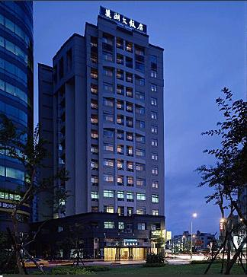
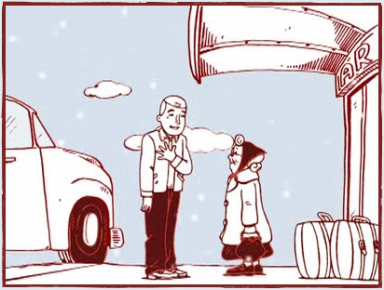
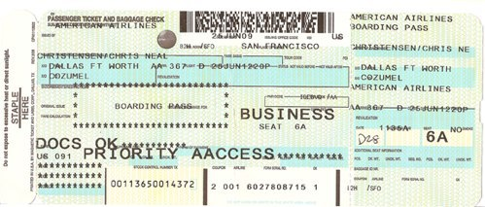
Arrangements for Local and Overseas Participants

Slide 8
Poster for Publicity
Relevant Information:
Elements:
Manifest the theme
Show the venue
Tell the date
Show the main organizer and how to contact
Show the main sponsor
Clear in information
Attractive in style

Slide 9
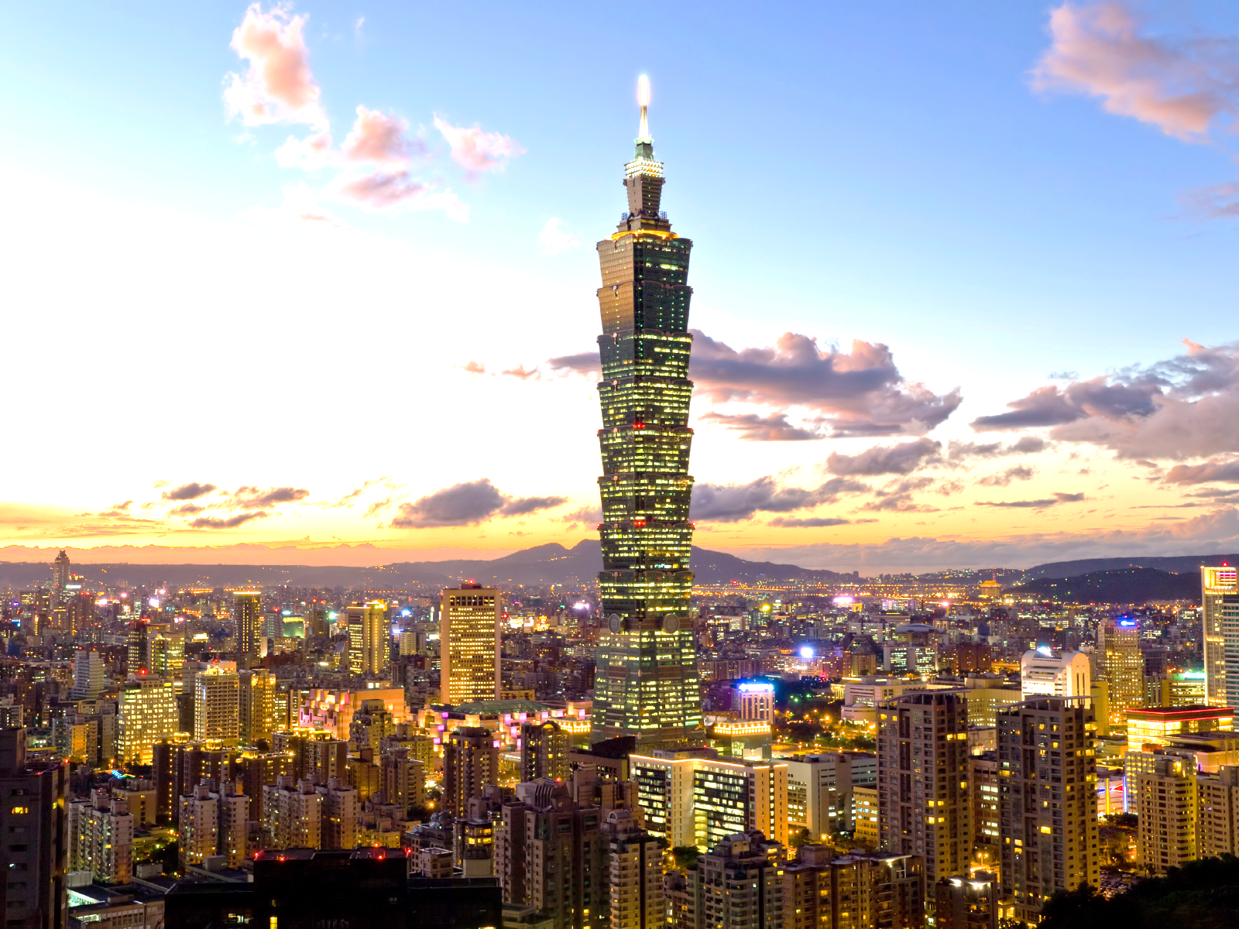
A failed poster…
Venue:: Taipei International Convention Center
Organization: Bureau of Foreign Trade
Asian MICE Conference:
Meeting , Incentives, conference, exhibitions & events
Date: October 10, 2014

Slide 10
Meeting
Incentive
Conference
Exhibition
&Events
Asian MICE Conference
Get in trends with…
MICE
Date: October 10, 2014
Venue: Taipei International Convention Center
(1 Hsin-Yi Rd.,Sec.5,Taipei 11049,Taiwan ROC)
Organization: Bureau of Foreign Trade (http://www.trade.gov. ,
for mobile)

Slide 11
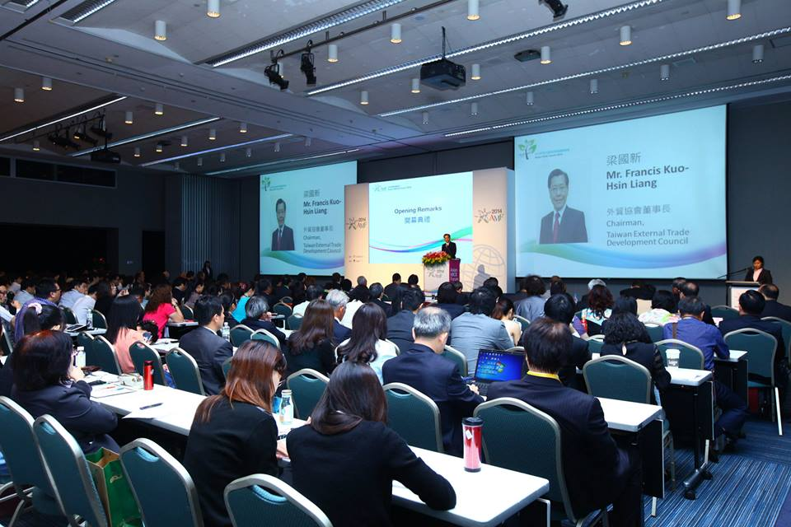
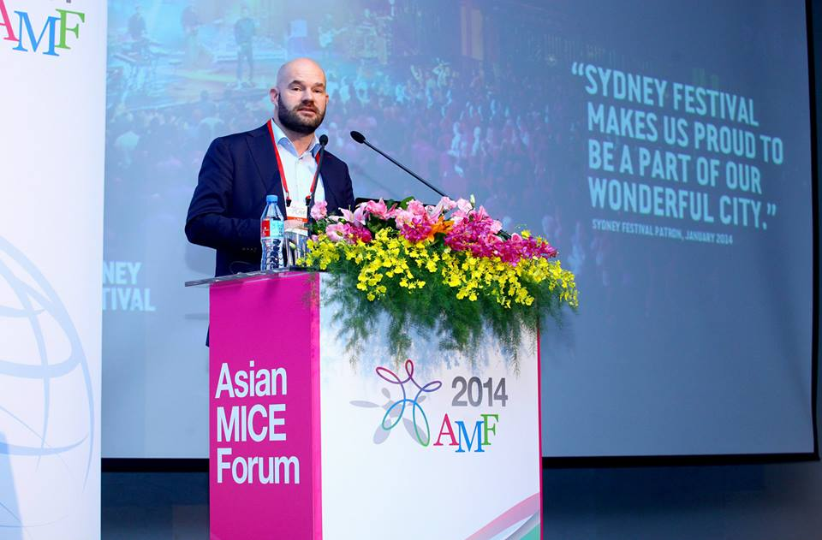
Venue Logistics
On-site equipment
Decorations and Installations
Photocopiers
Fax machines
Internet access
Seats
Podium
Flowers

Slide 12
Arranging Staff
Interpreters and on-site bilingual staff
An English-speaking master of ceremonies
Making security arrangements for VIPs

Slide 13
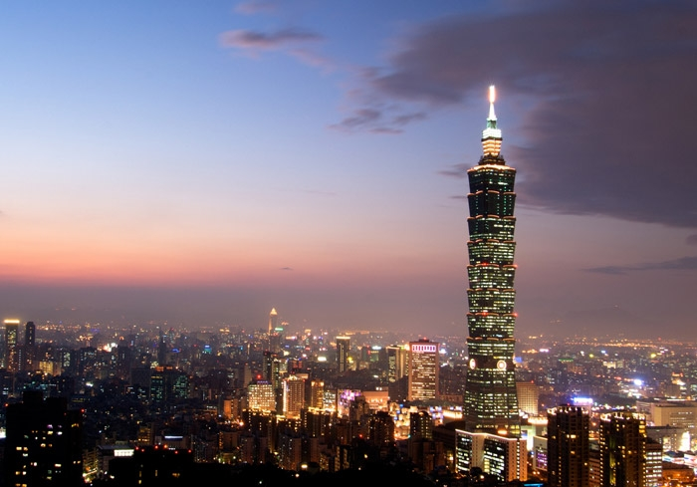
Hospitality
Offering typical Taipei attractions

Slide 14
Workflow for an International Conference
Pre- conference Preparations
Decide Conference Theme
Draw up Budget
Reserve Venue & Accommodations
Formulate Fundraising Plan
Decide Themes for Papers

Slide 15
Administration: Arrangement of Detailed Things
Announce Conference
(Initial and Follow-up Publicity)
Arrange
Interpreting/ Equipments
Select Papers for Presentation
Arrange Staff
Arrange Venue Logistics
(Equipment/Decorations)
Arrange Transport to and from Airport

Slide 16
Post- conference
Issue Proceedings
Settle Accounts

Slide 17
Thanks for your listening!

